Slide 1

BINANCE TRADING BOT STRATEGY
MODERN DATA ARCHITECTURES FOR BIG DATA II
RAUL MARIN PEREZ
GROUP H
JUAN LUIS BETANCUR BOTERO, MANUEL MARINA HERRERA, ALICE SEYNAEVE, KRISHNA AGRAWAL, ALI ELMONOFY , THOMAS AUGUST MARIA STENGER, ANTOINE DE MAINTENANT

Slide 2

TABLE OF CONTENTS
Context & Goal
Overview of Data-Pipeline
Batch Data
Ingestion & Storage
Transformation
Analysis
Trading Strategy
Streaming Data
Ingestion & Storage
Processing
Serving
Conclusion

Slide 3

CONTEXT
Crypto currency markets are highly volatile
Strong correlations in market between different currencies
Bull & bear cycles led by BTC with other cryptos following
Identifying this relationship early enough in the cycle can help to define trading strategy
Looking at different cryptos based on their market capitalization traded against USDT (stable coin for USD)
Large Caps (Mcap > $1billion)
XRP
ADA
MATIC
BNB
VET
LINK
Mid Caps (Mcap between $1billion - $250 million):
YFI
UMA
WAXP
ICX
ZRX
SUSHI
Small Caps (Mcap <$250 million):
BETA
REP
VTHO
XVG
VOXEL
CLV

Slide 4
CONTEXT & GOAL
We will focus on trading data provided by Binance
Binance is a one of the largest cryptocurrency exchange in terms of daily trading volume of cryptocurrencies
It was founded in 2017 and is registered in the Cayman Islands
It provides:
Cryptocurrencies trade data ,
Order book data,
Blockchain and historical data,
social data,
Reports and a suite of cryptocurrencies indices,
Trading Markets
Our goal:
Ingest batch & streaming data
Store both data types safely
Process the data to identify patterns and cryptos to profitably trade in real-time
Serve the results of our strategy with an adequate technology

Slide 5


HYPOTHESIS
Cryptos with lower market capitalization follow the behavior of Bitcoin.
OBJECTIVE
Create a strategy by looking at correlations of coins with Bitcoin lags. Simulate returns to see if strategy is profitable.
Buy Moment
Sell Moment
Detect Trend
Other
Other follow
previous trend
Bitcoin
0
1
2
Notes:
bitcoin is the biggest one, probably the smaller (less familiar) ones follow the same trend so we want to anticipate and buy it before the returns grow

Slide 6
Trading Strategy Concept
Find correlation of a given coin with a given bitcoin lag
Backtest it with historic returns
Detect the pattern to buy when bitcoin grows
Keep the crypto and the lag if the strategy works
Store the results in serving layer to evaluate strategy
Notes:
4) AND the relevant lag
5) to see if strategy works

Slide 7
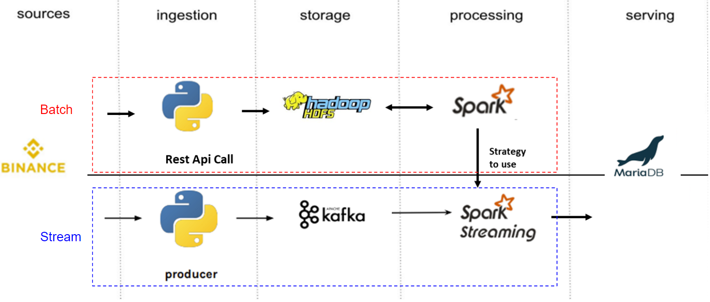
OVERVIEW OF DATA-PIPELINE
Notes:
This is similar to a Lambda Architecture because we are using the 3 batches batch/stream/serving
information comes from Binance this is our source, with the rest API call then we store it in HDFS, we process with Spark to find the correlations, then we have the strategy to use as well and we go to the streaming part, using python producer that is storing information in Kafka topic, then we create a dataframe implementing he strategy we found in the batch and then we serve it with Maria DB

Slide 8
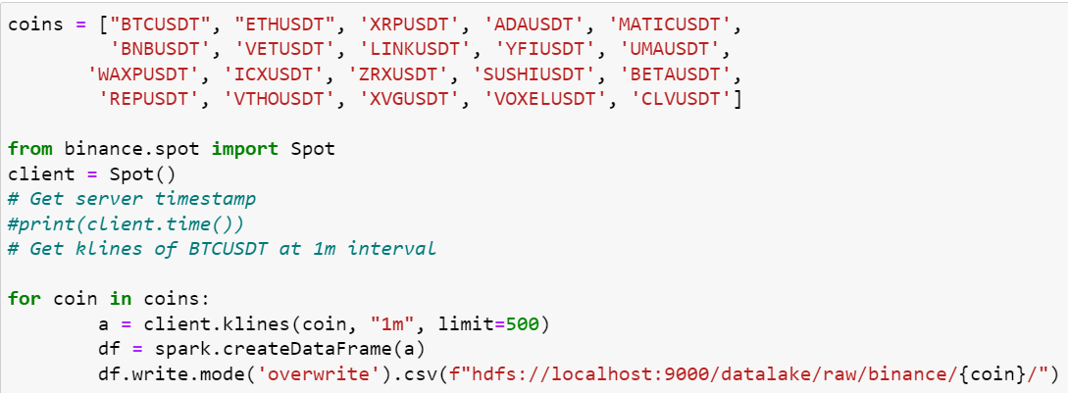
BATCH DATA INGESTION & STORAGE
Initialize Hadoop in Terminal – Hadoop-start.sh
Relevant crypto data per coin will be stored in raw-layer in HDFS
Each crypto currency has individual folder for better organization
Klines to be used = 1 minute
This ensures the real-time nature of this strategy
Notes:
Manu:
K-lines → 1m near real time
500 data points

Slide 9
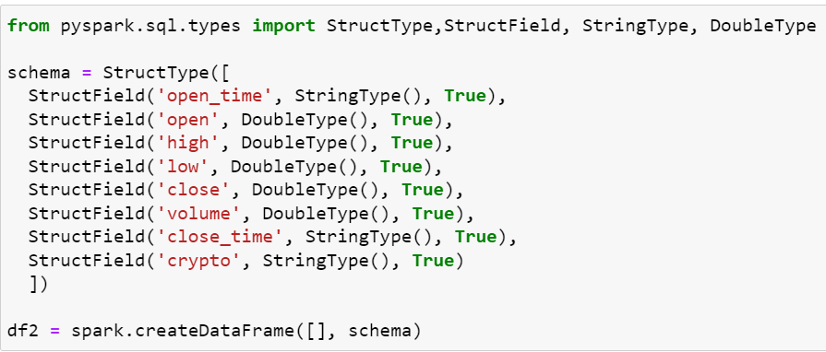
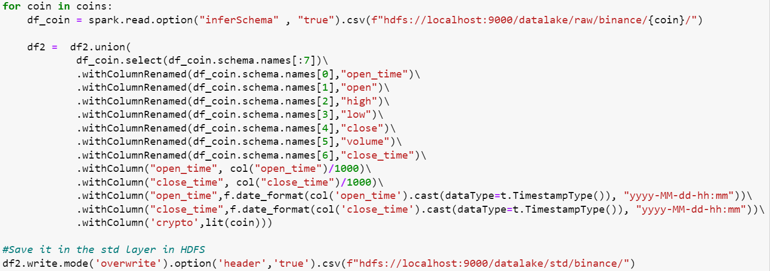
BATCH DATA TRANSFORMATION
Need to transform the data types for data ingested from Binance API - needed for PySpark data handling
Creation of a unified dataframe with all crypto data and storing it in standard layer
Notes:
Manu:
Double Type
Column rename → Open and Close time = Make it a timestamp

Slide 10
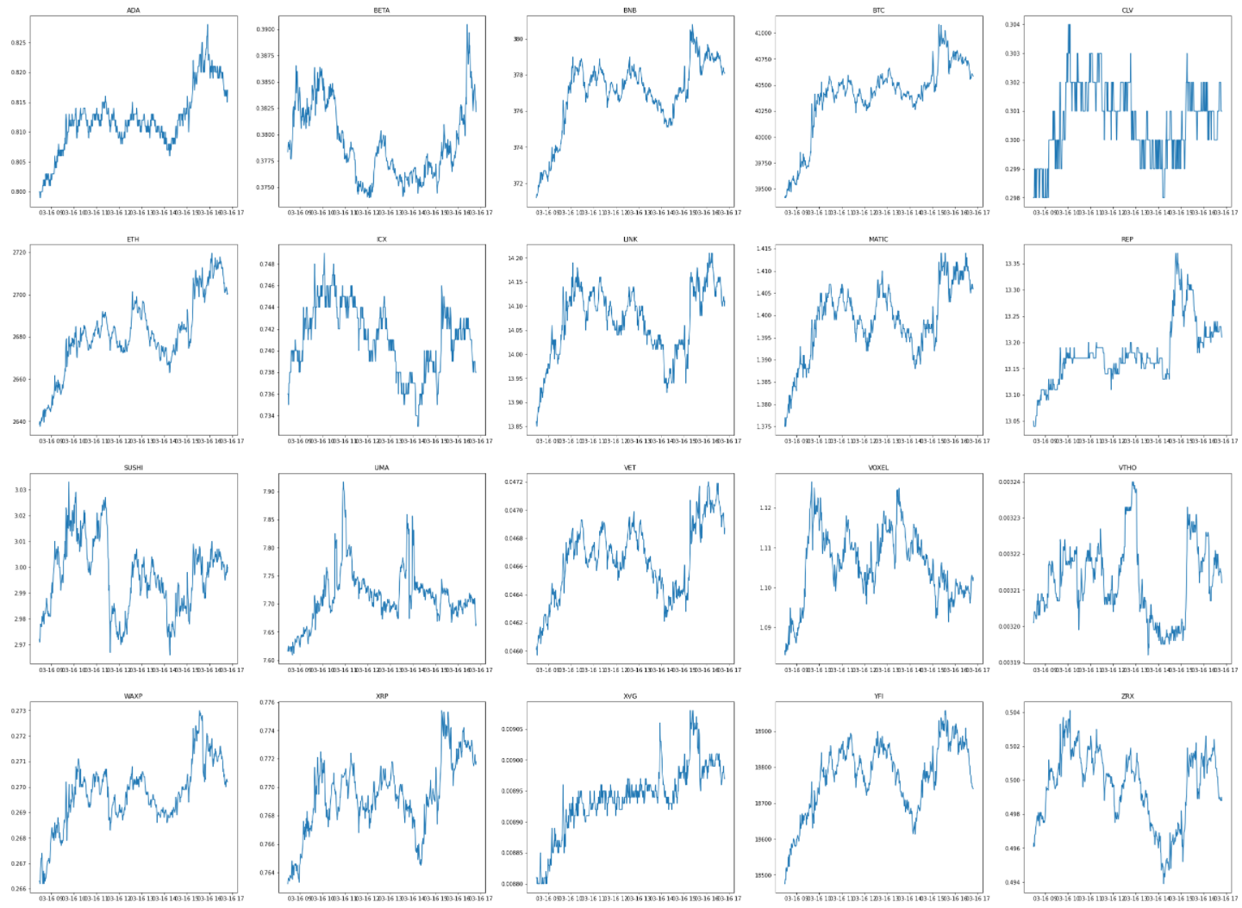
BATCH DATA ANALYSIS I
Graphs show klines open prices of all selected cryptos
Insight 1: Most price trends follow very similar patterns and confirm the bull/bear-cycle thesis
Insight 2: There are a some cryptos not following the trend too closely such as CLV (5th graph in first row)
Need to examine correlations more closely

Slide 11
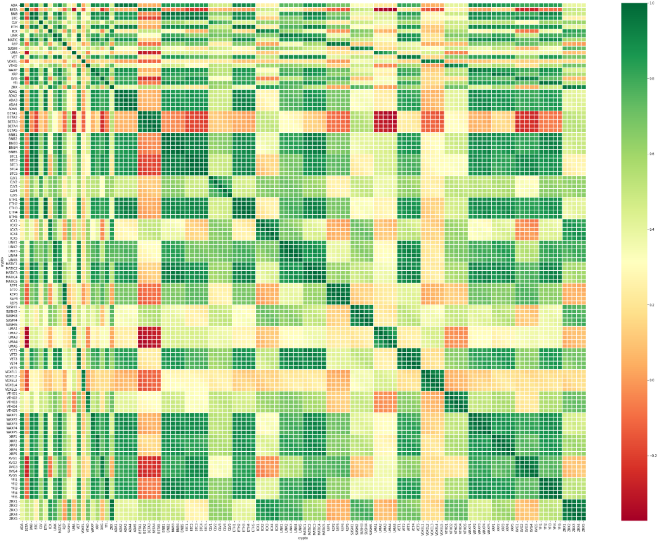
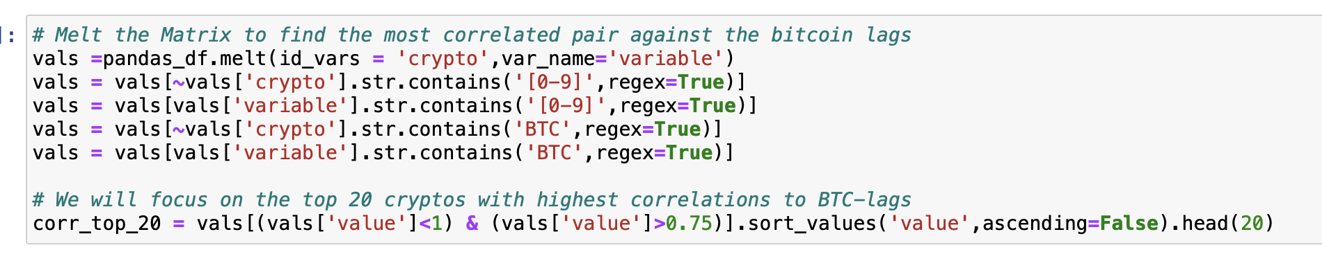
BATCH DATA TRADING STRATEGY I
Using Spark ML > Correlation
For our strategy we are identifying the cryptos that show the highest correlation to any given BTC lag - We chose 1-5 klines
Backtesting strategy by extracting the top 5 of correlated cryptos with respective lag and simulating returns

Slide 12
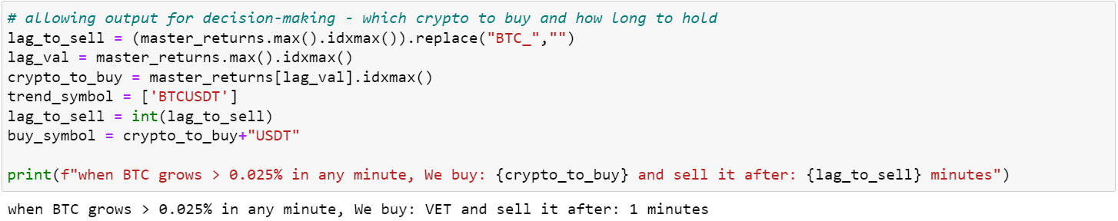
BATCH DATA TRADING STRATEGY II
Backtested strategy for best results in past 100 minutes
The final output defines our decision:
Crypto to buy: Vechain (VET)
Holding Period before selling: 1 kline (= 1 minute)

Slide 13
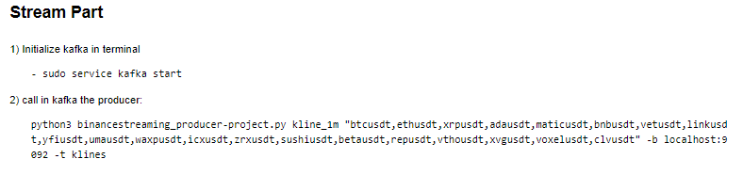
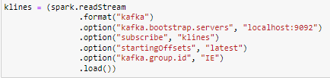
STREAMING DATA INGESTION & STORAGE & SPARK ACCESS
Need to start the Kafka Service & Call the Binance Producer - connecting to Binance API for streaming ingestion
Need to read the Kafka streams back into the Spark environment

Slide 14
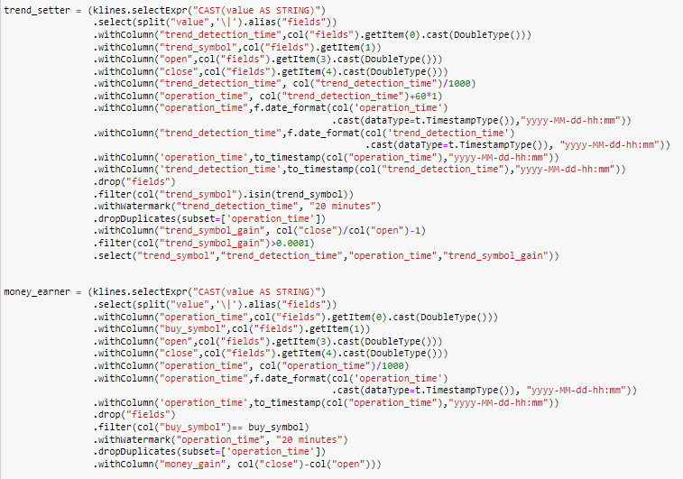
STREAMING DATA PROCESSING
Creating two dataframes: 1) DF to identify BTC trend; 2) Selecting which crypto we should buy/sell
Watermark
Stream Deduplication
Trend_setter: DF looking at BTC performance per klines to apply strategy – each kline output with buy=“yes/no”
Money_earner: DF containing gains for each kline for crypto selected by strategy
Account: Stream DF with info on gains/losses – buying in trend_setter detection time & sell in operation time
Stream - Stream Join

Slide 15
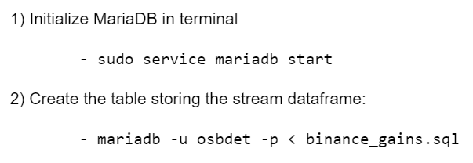
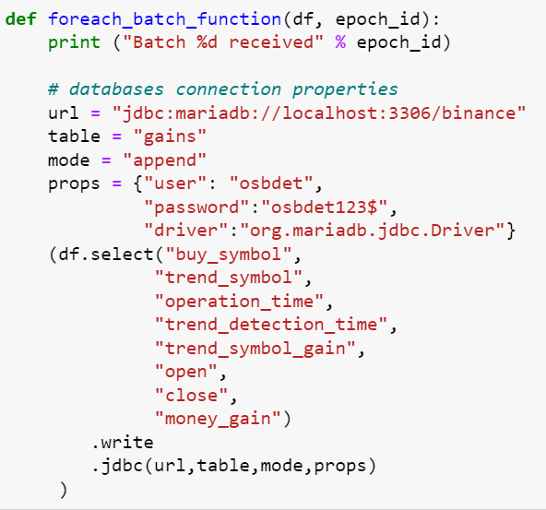
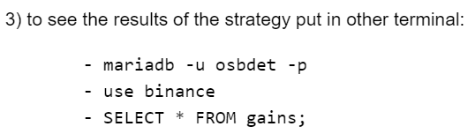
STREAMING DATA SERVING
Allows writing in MariaDB
We are handling only small data in this step - 20 rows and 8 columns = 160 Data points
Serving this using a SQL database (MariaDB)
Code is connecting properties of the dataset into relational database
MariaDB:
Start MariaDB in new kernel
Create new table called “Binance”
Place gains/losses from our transaction in table
- Ready to serve and hopefully make profits!
Trigger Policy

Slide 16
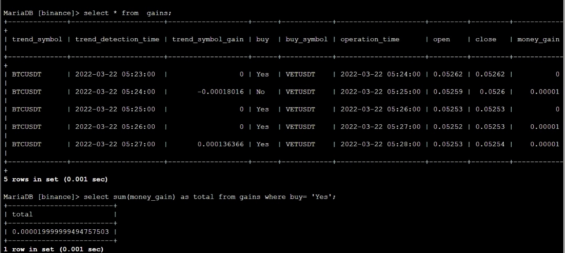
CONCLUSIONS
HDFS & Kafka environment
Batch & Stream processing using Binance API
Back testing investment strategy in Spark
Serving with MariaDB & made profit in first 5 minutes
Strong foundation for testing different strategies & ability to link to bot to execute trades

Slide 17
THANK YOU FOR YOUR ATTENTION!

